Slide 1
Big RDF Graph query based on Hadoop
Presently , there are essentially two ways to process big RDF Graph query in Hadoop environment:
(1) SPARQL--->hadoop jobs by several optimization(such as data partitioning...)
(2) SPARQL ---->Pig Latin--->hadoop jobs
(such as PigSPARQL、RAPID+...)

Slide 2
Title: Scalable SPARQL Querying of Large RDF Graphs
Conference/Journal: VLDB
Author: Jiewen Huang , Daniel J. Abadi
Time: 2011

Slide 3
Introduction
It introduces a scalable RDF data management system that is up to three orders of magnitude more efficient than popular multi-node RDF data management systems.
(1) leveraging state-of-the-art single node RDF-store technology(RDF-3X)
(2) partitioning the data across nodes in a manner that helps accelerate query processing through locality optimizations
(3) decomposing SPARQL queries into high performance fragments that take advantage of how data is partitioned in a cluster.

Slide 4
Major Contributions
• Introduce the architecture of a scalable RDF database system that leverages best-of-breed single node RDF-stores and parallelizes execution across them using the Hadoop framework.
• Describe data partitioning and placement techniques that can dramatically reduce the amount of network communication at query time.
• Provide an algorithm for automatically decomposing queries into parallelizable chunks.
• Experimentally evaluate the system to understand the effect of various system parameters and compare against other currently available RDF stores.

Slide 5
Main Process
1.Use graph partitioner module to perform a disjoint partitioning of the RDF graph by vertex.(open source graph partitioner)
2.According to Triple placement algorithm and the output of the partitioning algorithm, input triples are assigned to worker machines.
3.The master accepts and analyzes the queries, then executes them by different strategies.

Slide 6
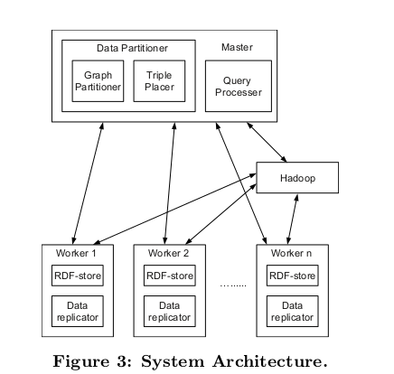
SYSTEM ARCHITECTURE

Slide 7
Data Partitioning
The graph partitioning scheme consists of two steps:
1.Divide vertexes of an RDF graph into disjoint partitions based on METIS partitioner.(a popular graph partitioner)
2.Assign triples to partitions based on the original RDF graph, the output of vertex partitioning and other parameters (implemented by a hadoop job)

Slide 8
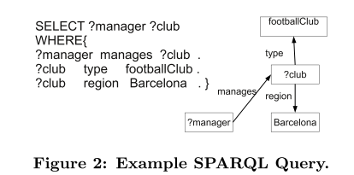
Triple Placement(1)
The most straightforward way to implement triples is to simply check the subject for each triple and place the triple in the partition that owns the vertex corresponding to that subject(hashing method).
Problem?
Too much I/O cost and network communication

Slide 9
Triple Placement(2)
Optimization method:
Allow some triples (particular those triples whose subject is on the partition boundary) to be replicated across partitions.
It can be regarded as a trade-off between storage overhead and communication overhead.
So it needs a measure to specify the amount of overlap, the paper uses a directed(undirected) n-hop guarantee as the parameter.

Slide 10
Triple Placement(3)
1-hop: for a set of vertexes assigned to a partition, 1-hop calculates all vertexes in the complete RDF graph that are connected via a single edge from any vertex already located within the partition, and adds this set of vertexes along with the edges that connect them to the original set of vertexes in the partition.(n-hop can be also computed by similar iterations)
Advantage:

Slide 11
QUERY PROCESSER
Queries are executed in RDF-stores or
Hadoop based on the kinds of queries:
1)PWOC query
(parallelizable without communication):
These queries can be answered entirely in RDF-stores without data shuffling in Hadoop.
2)non-PWOC query:
It decomposes the query into PWOC subqueries. We then use Hadoop jobs to join the results of the PWOC subqueries.

Slide 12
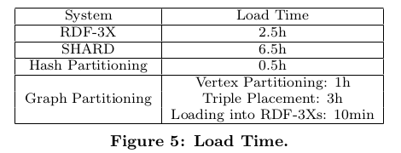
Experiment
1.Benchmark:LUBM data +LUBM query
(50 GB 270million triples+14 queries)
2.comparative systems: RDF-3X, SHARD
3. performance parameters: Loadtime+ query
time

Slide 13
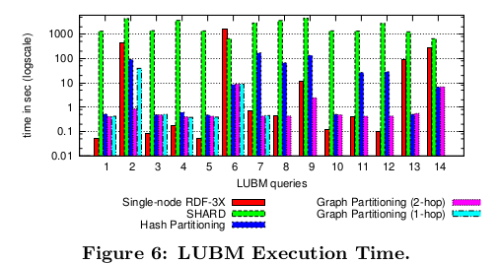
Experiment
Query classification:
1:fast query(1,3,4,5,7,8,10,11,12)
2:slow query(2,6,9,13,14)
Result:
For fast query, Single machine > cluster
For slow query, single machine<<cluster
The change of hop will affect certain kinds of queries such as 2、8、9

Slide 14
Title: from SPARQL to MapReduce: the journey using a nested tripleGroup algebra
Conference/Journal: VLDB
Author: HyeongSik kim, ravindra.
Time: 2011

Slide 15
Introduction
The paper demonstrates a system RAPID+, an extension of Apache Pig, enables more efficient SPARQL query processing on MapReduce using an alternative query algebra called the NTGA.

Slide 16
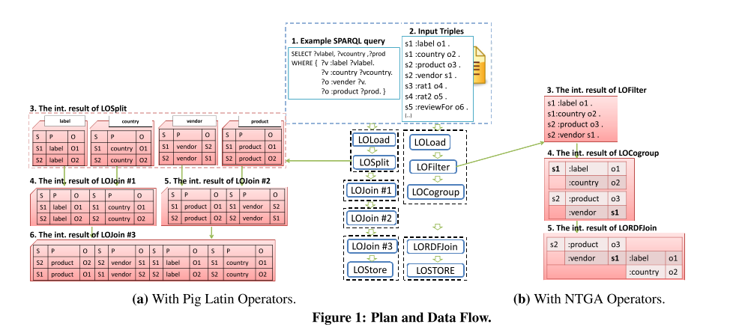
Main Process

Slide 17
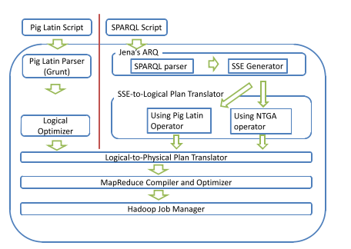
Overall execution flow

Slide 18
Lessons
1. these papers help us have a basic understanding of the process of sparql query, Pig Latin and data partitioning.
2. consider if we can combine the two methods to have a better query performance.
3.consider if we can utilize some iterative hadoop systems to address the problem such as haloop、pregel and so on.

Slide 19
References
Ravindra, Padmashree, HyeongSik Kim. "An intermediate algebra for optimizing RDF graph pattern matching on MapReduce." The Semanic Web: Research and Applications. Springer Berlin Heidelberg, 2011.
Sridhar, Radhika, Padmashree Ravindra"RAPID: Enabling scalable ad-hoc analytics on the semantic web." The Semantic Web-ISWC 2009. 715-730.
Ravindra, P., Deshpande, Towards scalable RDF graph analytics on MapReduce. Proceedings of the 2010 Workshop on Massive Data Analytics on the Cloud - MDAC

Slide 20
References
Neumann, T., & Weikum, G. (2009). Scalable join processing on very large RDF graphs. Proceedings of the 35th SIGMOD international conference on Management of data - SIGMOD ’09, 627.
Huang, Jiewen, Daniel J. Abadi, and Kun Ren. "Scalable SPARQL querying of large RDF graphs." Proceedings of the VLDB Endowment 4.11 (2011)
Myung, Jaeseok, "SPARQL basic graph pattern processing with iterative MapReduce." Proceedings of the 2010 Workshop on Massive Data Analytics on the Cloud. ACM, 2010.

Slide 21
References
Nie, Z., Du, F., Chen, Y., Du, X., & Xu, L. (2012). Efficient SPARQL Query Processing in MapReduce, 628–635.
Kim, H., Ravindra, P., & Anyanwu, K. (2011). From SPARQL to MapReduce: The Journey Using a Nested TripleGroup Algebra. PVLDB, 4(12), 1426–1429.

